Slide 1
Version and history
iBatis 2.0 I used in Nissan projects
iBATIS 3.0 they introduced Annotation and changed some API
iBATIS 3.0 is renamed as myBatis mybatis-3.0.4

Slide 2
iBatis is
Simple and Hybrid
It does not have any built in support for concurrency like hibernate support <version>
When u have full control of DB go for ORM tools
(JPA, Hibernate)
It does not have any built in support for cascade operation while update / delete.
It is not transform Checked SQLException exception to runtime exception like hibernate /spring

Slide 3
Why I want to use iBATIS
If DB is legacy and it is not well normalized go for ibatis
SQL is not standard. So, it is vary from DB to DB
When we want to avoid plain JDBC code and at the same time want control on SQL go for iBatis
When we want use DB specific features go for iBatis
Simplicity, easy to learn, less learning curve
It allow us to have separate SQL developer for our projects

Slide 4
What is iBATIS ?
iBatis is implementation of “Data Mapper” design pattern
Caching
It is SQL centric framework
SQL not generated. Developer has to write the SQL. But SQL Mapping is done
Externalizing SQL

Slide 5
What is abstraction layer ???
A method in abstraction layer should not expect any implementation specific or vendor specific class either as parameter or return type. The same method should NOT have any vendor specific exception in it is throws class.
When you have full control of application like DB design, go for Hibernate tool. If not, consider iBATIS

Slide 6
iBatis features
It is reduce / avoid JDBC code. iBatis use JDBC code in turn behind the scene
It is more extensible and customizable
It keep the SQL in famous XML
Lazy loading, join fetching are opposite.
Lazy load improve performance by reduce memory usage. But need one more sql query hit.
But Join fetch improve performance by reduce SQL hit. But occupy memory
It support pagination
It support batch processing
Lazy loading
Join Fetching

Slide 7
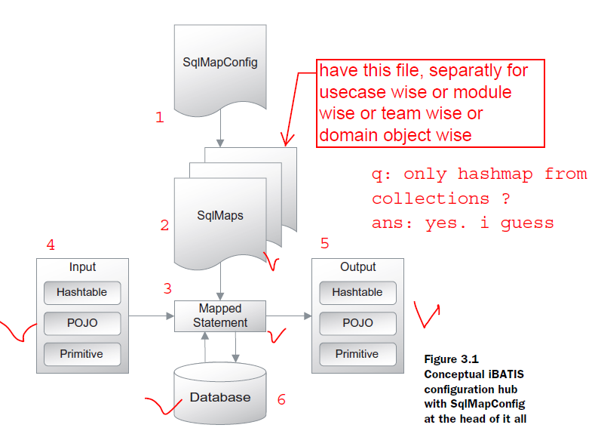
iBatis Architecture or work flow

Slide 8
iBatis configuration
As java developer use EMMA coverage with Junit to know how much source code tested.
One SQLMapconfig.xml
( it is master configuration like DB info. )
many sqlMap.xml file
( usually every module / use case / domain object will have separate sqlMap.xml file )
To use Lazy loading need byte code enhancement jar and need configuration in SqlMapCofig.xml file
<settings lazyLoadingEnabled=“true” />
<settings enhancementEnabled=“true” />
For DB connection pooling, DBCP can be used with ibatis
For caching OSCache
can be used with ibatis
<settings cachingEnabled=“true” />

Slide 9
iBatis SqlMap configuration features
Automatic Result Map
External Result Map
Single Column selection
Fixed Column list selection
Parameter Map
dynamic Column list selection
Inline parameters like #vale#
External parameters map <parameterMap>
Dynamic query is
SELECT, WHERE clause.
Reuse sql by <sql>, <include> element

Slide 10
Transaction capable resources
are
1. DB( Database)
2. JMS
3. JCA( java connector Architecture)
Use “automatic” transaction manager to run EVERY statement in separate transaction
Use “LOCAL” transaction manager to run ONE OR MORE statement AS GROUP in a transaction. But single Resource usually DB
Transaction Properties
Automicity
Consistency
Isolation
durability
Use “GLOBAL” transaction manager to run ONE OR MORE statement AS GROUP in a transaction on more than Resource usually DBs/ JMS

Slide 11
While using Dynamic SQL, we have to avoid refactoring java attribute and classes
Dynamic SQL
<dynamic>
binary
unary
<iterate>

